Slide 1

‘C++’ Programming Language
By:
Ekta Gupta

Slide 2
Language
Person 1
Person 2
Means of Communication
Languages like English , Hindi , Chinese etc.
English
English

Slide 3
Language
User
Machine
Means of Communication
Programming Languages like ‘C’ , ‘C++’ , Java
English
(High Level Language)
Binary form (0,1)
(Low Level Language)
Need Translator to convert High level to low level and vice versa. Like: Compiler , Interpreter or Assembler

Slide 4

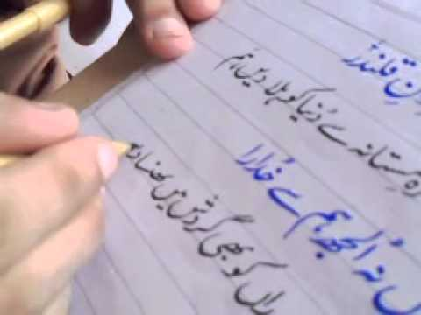
Language Approach
There are two ways to write language either:
Left to Right (E.g. English )
Right to Left (E.g. Urdu)

Slide 5
Programming Approach
There are two universal approach to write programming language either:
Procedural Programming (E.g. ‘C’ language)
Object Oriented Programming Language (E.g. ‘C++’ , ‘JAVA’ etc.)

Slide 6
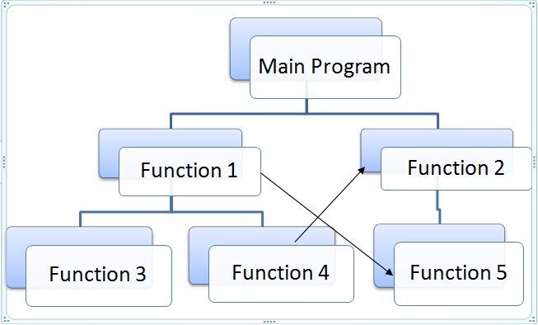
Procedural Programming (‘C’)

Slide 7
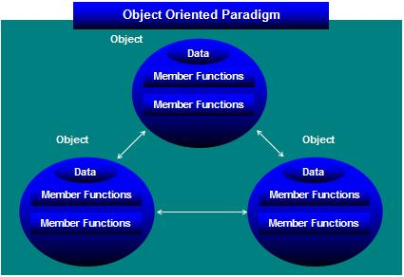
Object Oriented Programming Language (OOPs)

Slide 8
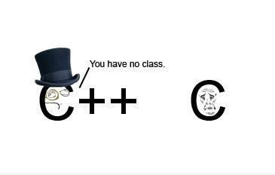
OOPS Programming (‘C++’)

Slide 9

Getting Started OOPs

Slide 10













Slide 11
Objects

Slide 12



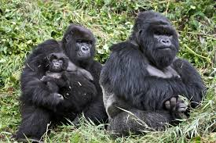
Class (Animals)
Collection of similar objects is called a class.

Slide 13

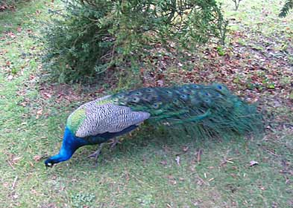


Class (Birds)
Collection of similar objects is called a class.

Slide 14



Class (Actors)
Collection of similar objects is called a class.

Slide 15
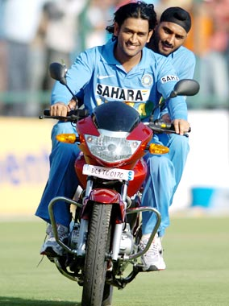


Class (Players)
Collection of similar objects is called a class.

Slide 16
C++ Overview
C++ is a
Statically typed, compiled, general-purpose, case-sensitive, free-form programming language that supports procedural, object-oriented, and generic programming.
C++ is regarded as a middle-level language, as it comprises a combination of both high-level and low-level language features.
Note: A programming language is said to use static typing when type checking is performed during compile-time as opposed to run-time.

Slide 17
C++ Overview
C++ was developed by Bjarne Stroustrup in 1979 at Bell Labs ,Murray Hill, New Jersey.
It is an enhancement to the C language and originally named ‘C with Classes’ but later it was renamed ‘C++’ in 1983.
C++ is a superset of C, and that virtually any legal C program is a legal C++ program.

Slide 18

C++ Overview
C
C++
Superset of ‘C’
Subset of ‘C++’
Bjarne Stroustrup

Slide 19
Object-Oriented Programming
C++ fully supports object-oriented programming, including the four pillars of object-oriented development:-
Encapsulation
Abstraction
Inheritance
Polymorphism

Slide 20
C++ Basic Syntax
C++ can be defined as a collection of objects that communicate via invoking each other's methods.
Object - An object is called an instance of a class because it has the copy of all the data members and member functions declared inside the class.
Class - A class can be defined as a category,plan,template/blueprint that describes the object of its type support.

Slide 21
C++ Basic Syntax
Class Functions (Member Functions) - A class can contain many functions. It is in functions where the logics are written, data is manipulated and all the actions are executed.
Class Variables(Data Members) - Each object has its unique set of variables.

Slide 22
C++ Identifiers
C++ identifier is a name used to
Identify a variable, function, class, module, or any other user-defined item.
An identifier starts with a letter A to Z or a to z or an underscore (_) followed by zero or more letters, underscores, and digits (0 to 9).
C++ does not allow punctuation characters such as @, $, and % within identifiers.
C++ is a case-sensitive programming language.

Slide 23
C++ Identifiers
Thus, Manpower and manpower are two different identifiers in C++.
Here are some examples of acceptable identifiers:
name move_name b
Salary _age A_temp
a_123 myname50 a23b9
retVal sum Employee

Slide 24
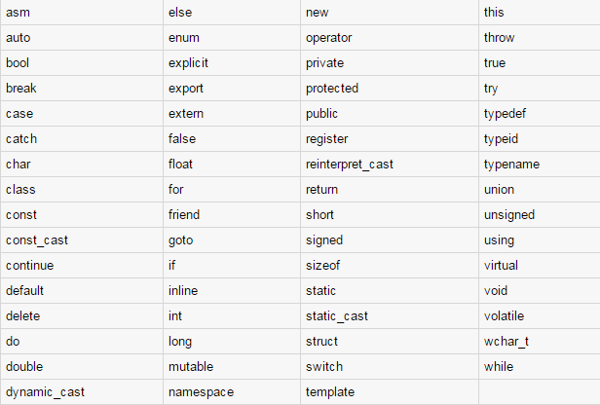
C++ Keywords
Keywords are the reserved words and these reserved words may not be used as constant or variable or any other identifier names.

Slide 25
Whitespace
A line containing only whitespace, possibly with a comment, is known as a blank line, and a C++ compiler totally ignores it.
Whitespace is the term used in C++ to describe blanks, tabs, newline characters and comments.
Whitespace separates one part of a statement from another and enables the compiler to identify where one element in a statement, such as int, ends and the next element begins.
int age;
There must be at least one whitespace character (usually a space) between int and age for the compiler to be able to distinguish them.
sum= a + b ; // get the total of value of a and b
No whitespace characters are necessary between sum and =, or between = and a,
although you are free to include some if you wish for readability purpose.

Slide 26
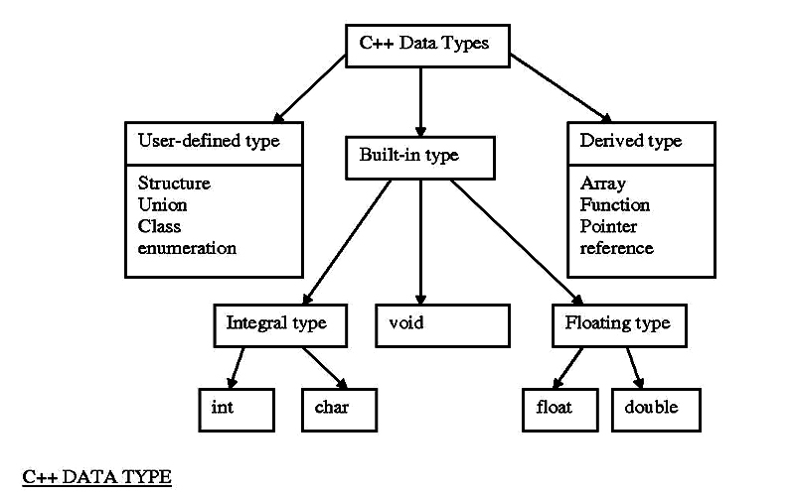

Slide 27
Built-in Data Types
Built-in DataTypes – Built-in Datatypes are like the cups at the Coffee-House.
They come in different sizes and each has name like
Small , Medium and Big

Slide 28
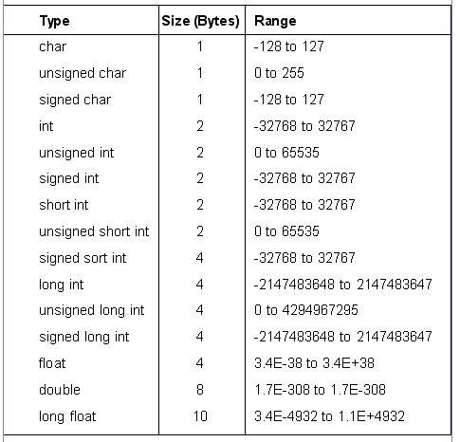

Slide 29
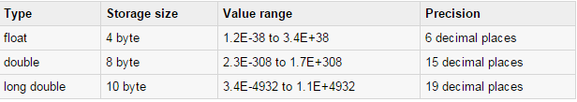
Point to Remember

Slide 30
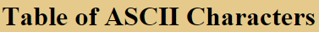
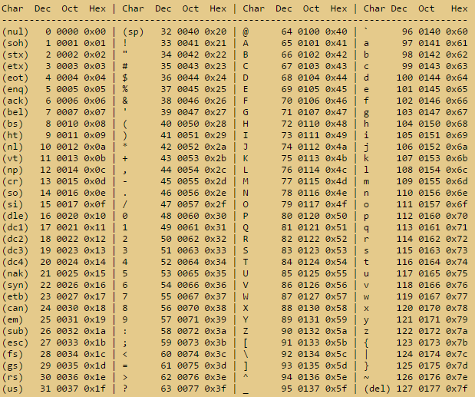

Slide 31
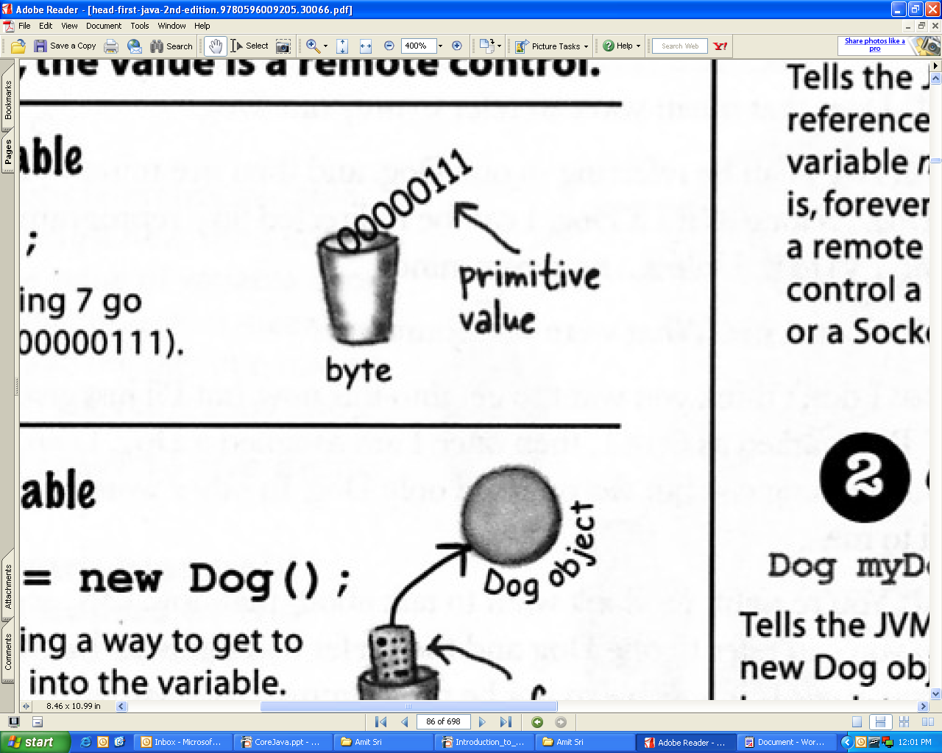
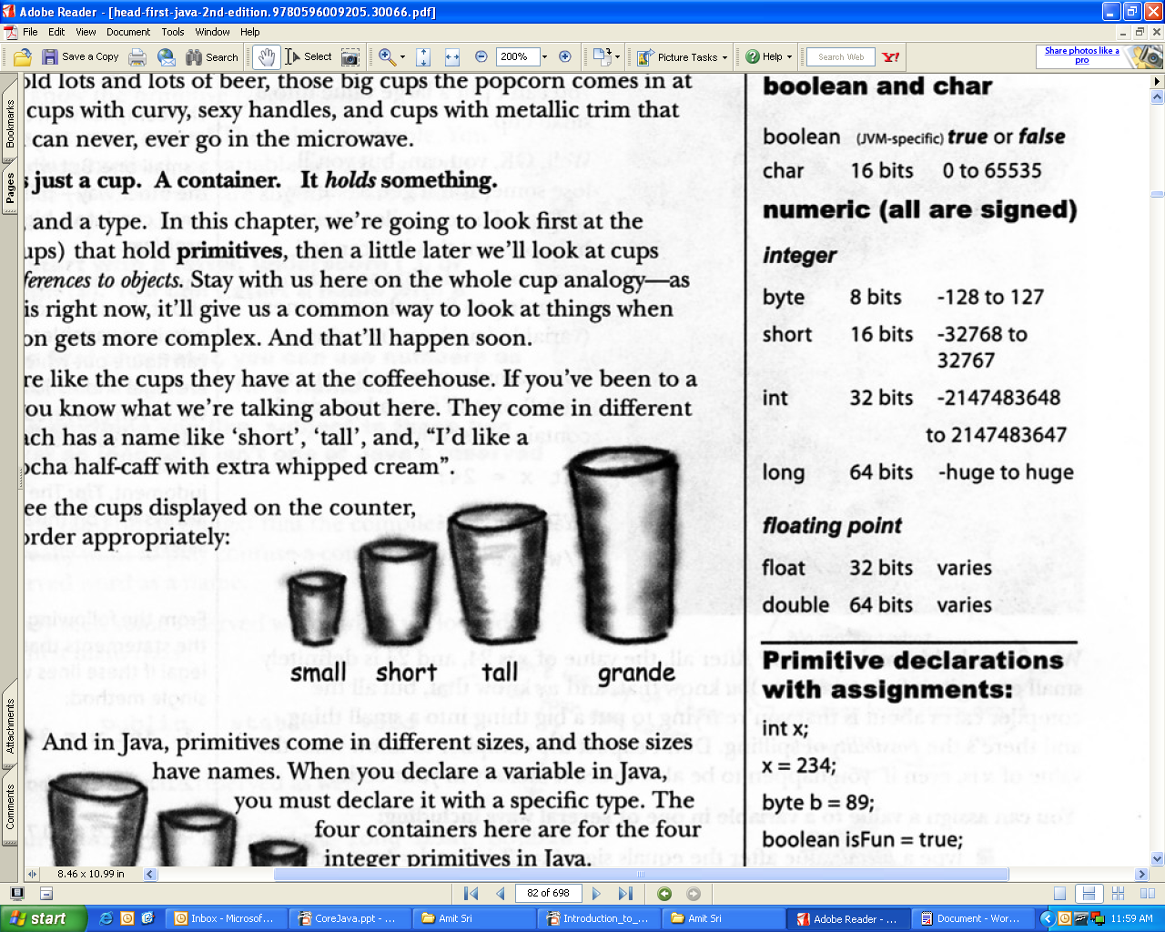
Variable
A variable is just like a cup or container. It can hold something. It has a size and a type.
Sample Example
int a=123;
a

Slide 32
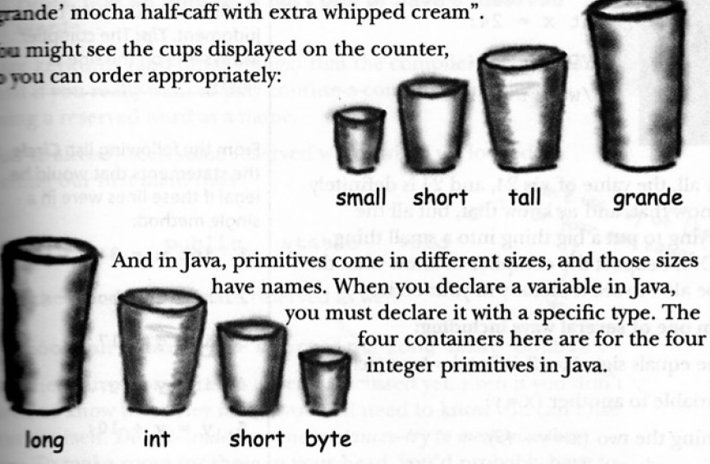
Inbuild Type Example
char a = ‘b’ ; // Takes 1 byte in the memory
int a=10; // Takes 2 bytes in memory
float =5.5; // Take 4 bytes in memory

Slide 33
Constant
As the name implies , constants are fixed values which never change during the execution of the program.
The const Keyword
You can use const prefix to declare constants with a specific type as follows:
Example:
const int MAX=100;
const float PI=3.14;

Slide 34
C - Operators
An operator is a symbol that tells the compiler to perform specific mathematical or logical manipulations.
Types of operators:
Arithmetic Operators
Relational Operators
Logical Operators
Bitwise Operators
Assignment Operators
Misc Operators

Slide 35
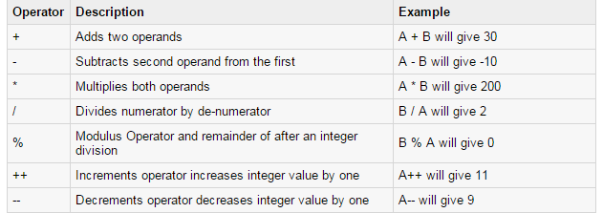
Arithmetic Operators

Slide 36
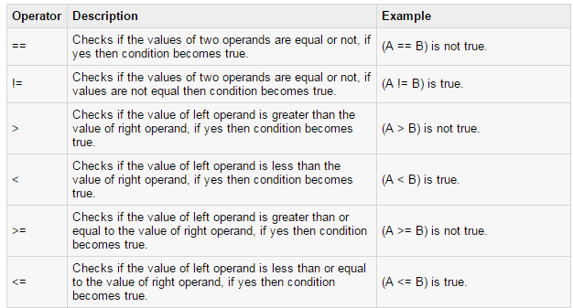
Relational Operators

Slide 37
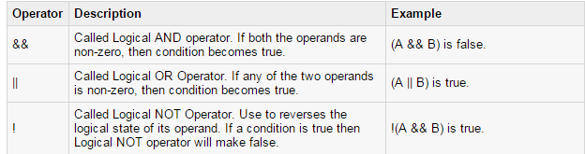
Logical Operators

Slide 38
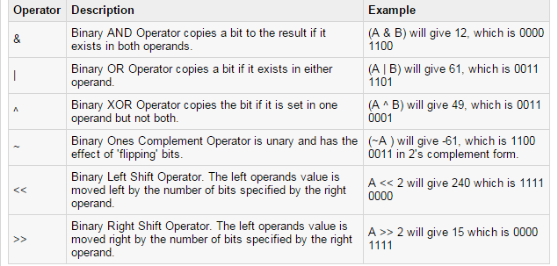
Bitwise Operators
Bitwise Operators works on bits and perform bit-by-bit operation. Like:- &, |, and ^

Slide 39
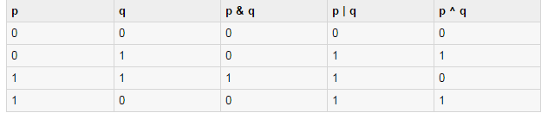
Truth Table of Bitwise Operators

Slide 40
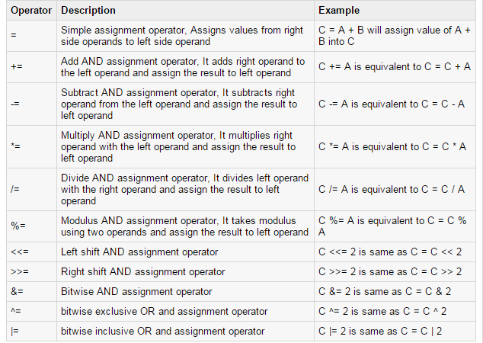
Assignment Operators

Slide 41
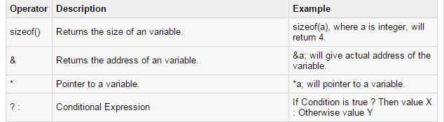
Misc Operators ↦ sizeof & ternary
There are few other important operators like :-
sizeof and ? and :
Example :
int a=10 , b;
b=(a==10)?2:3
printf(“\n value of b is %d ”,b);
Output:
value of b is 2

Slide 42
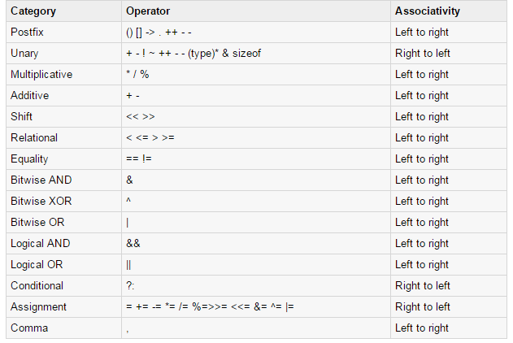
Operators Precedence in ‘C’
For Example
x = 7 + 3 * 2;
Here, x is assigned 13, not 20 because operator * has higher precedence than +, so it first gets multiplied with 3*2 and then adds into 7.

Slide 43
C++ Hello World Example
C++ program basically consists of the following parts:
Preprocessor Directives
Defining Class
Declaring data members as private
Declaring member functions as public
Main Function
Declaring objects of the class

Slide 44
Example
#include <iostream.h>
#include <conio.h>
class Hello
{
int a;
public:
void showdata()
{
cout<<“Hello! World…”;
}
} ;
void main()
{
/* my first program in C++ */
Hello h;
h.showdata();
}
Pre processor directives
Declaring class
Data Member ..private keyword is optional
Member function..public keyword is mandatory to declare
Main function
Comments
Declaring object

Slide 45


Decision Making / Conditional Statements
1) Using if-else
2) Using switch
3) Using Ternary Operator (? , :)

Slide 46
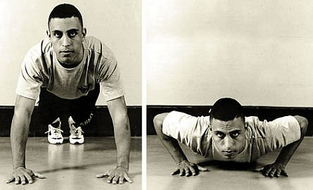
LOOPING
When you want to repeat something for definite number of times,
it is called loop.
Three basic loops
for
while
do-while

Slide 47
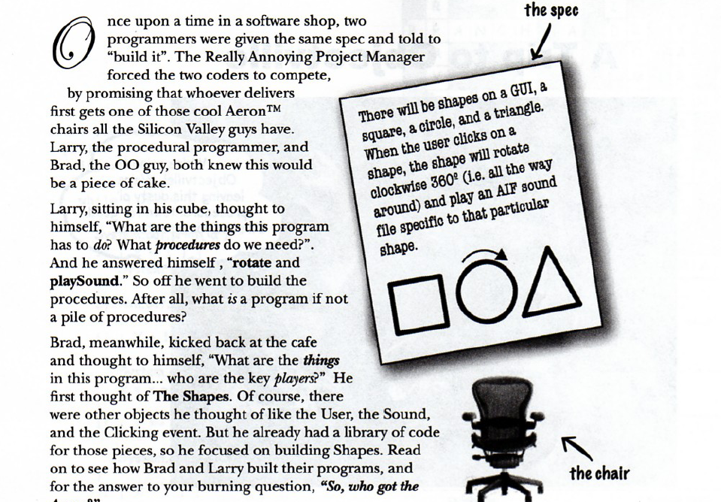
Procedural Vs OOPs

Slide 48
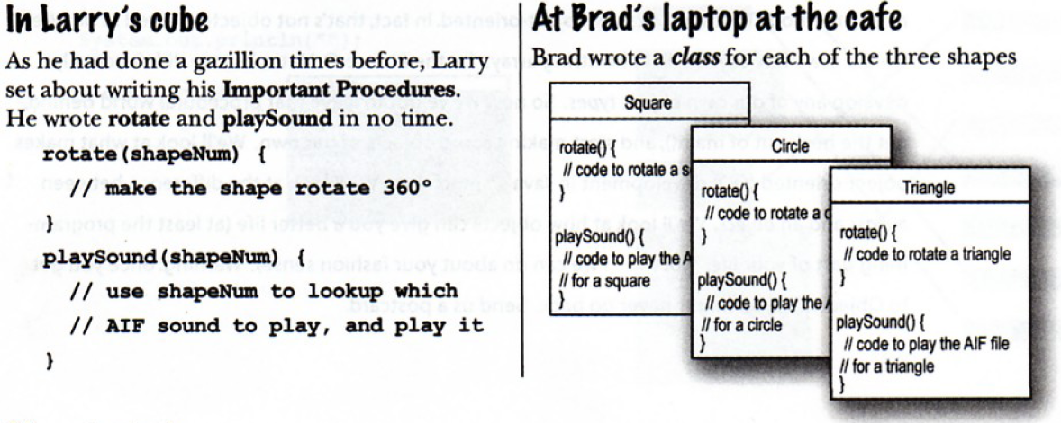
Procedural Vs OOPs
Contd….
*

Slide 49
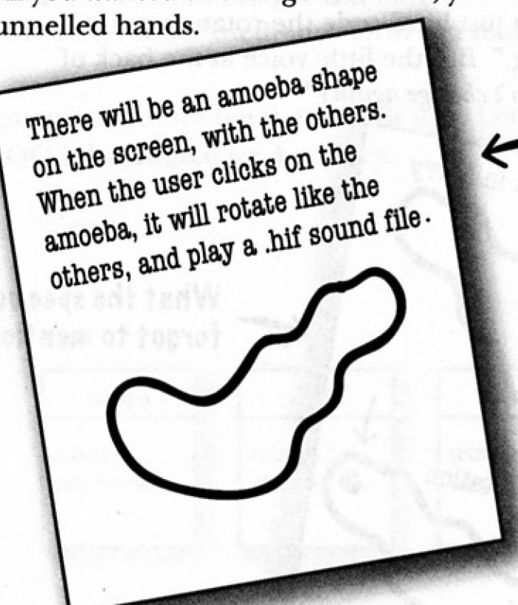
Procedural Vs OOPs
Contd….
Add one more shape in your current program
*

Slide 50
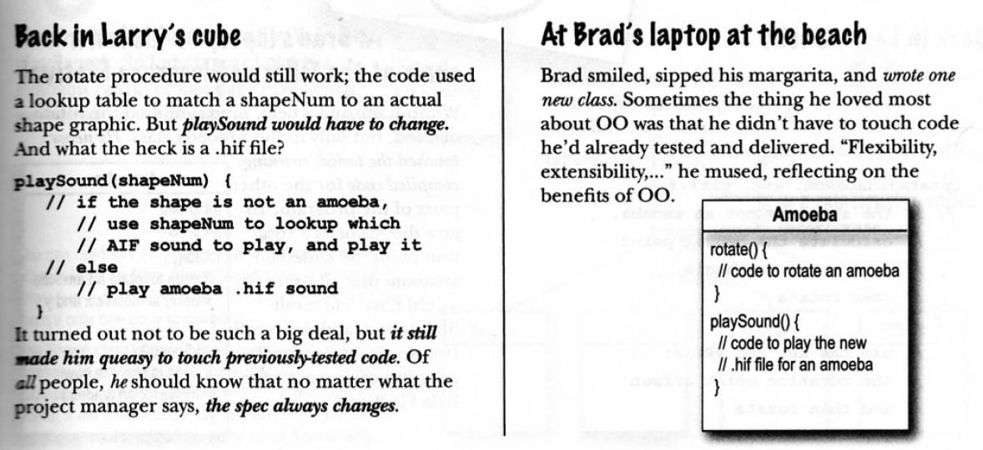
Procedural Vs OOPs
Contd….
*

Slide 51
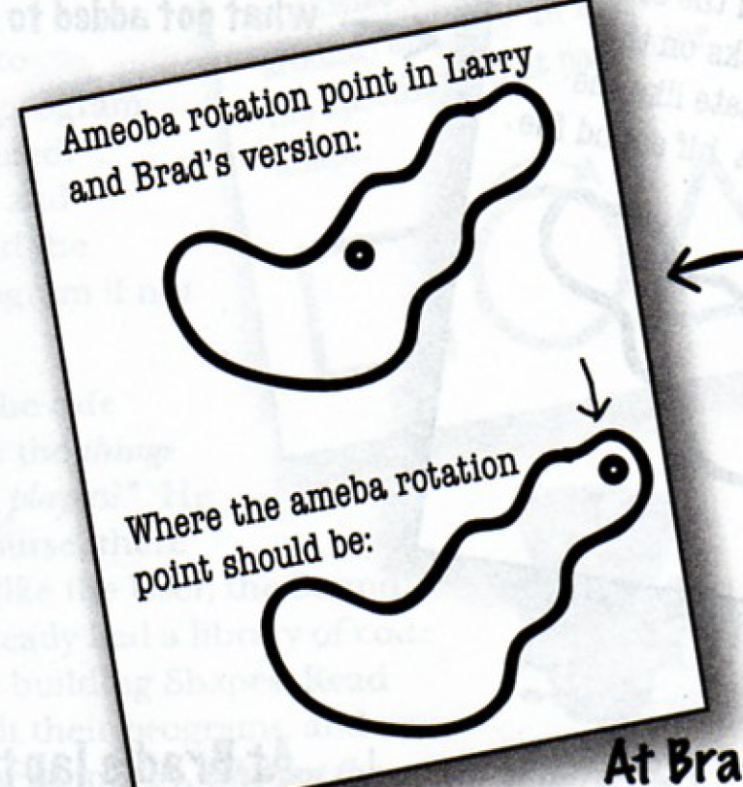
Procedural Vs OOPs
Contd….
*

Slide 52
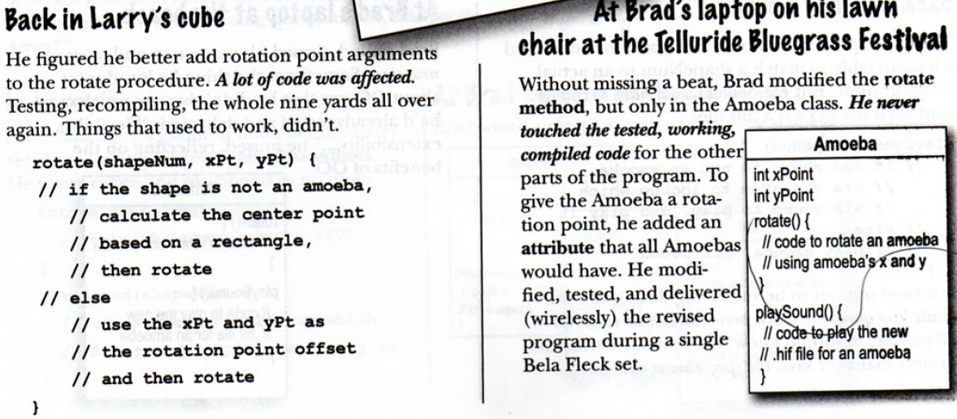
Procedural Vs OOPs
Contd….
*

Slide 53
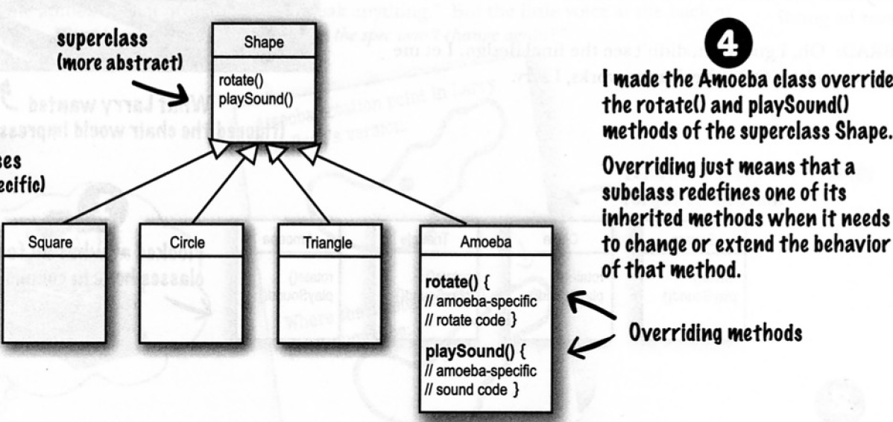
Procedural Vs OOPs
*

Slide 54
POP vs OOP
Procedural Oriented Programming | Object Oriented Programming
Programs are made up of procedures, which are set of statements | Programs are made up of modules
Programs cannot be tested separately in procedures. | Programs can be coded and tested separately in modules, and then assembled to form a complete program
Software maintenance can be difficult and time consuming | Software maintenance is relatively easy due to classes and objects
Less secure (No proper Data hiding) | More Secure (Provides Data Hiding)
No Overloading | Overloading is possible

Slide 55
Program Structure
class Employee
{
}; ----→class should be terminated by semicolon
void main( )
{
}
int a;
char name[20];
Data members
By default private
public :
void getdata( )
{
}
Member functions
Need to be declared public
Main Method
// ClassName object ;
Employee e;
e.getdata( );
Object Declaration

Slide 56
Class Vs Object
class Employee
{
char name[20];
void work(){}
}
Employee karan;
karan.name = “ ”;
karan.work();
Employee kunal;
Class
Object
Template/blue print of object
Behaviors & States
Binds data members and methods into a single unit
Instance/variable of class
Logical exist
Physical exist
Definition is created once
Can be created many times

Slide 57
File Handling in C++

Slide 58
File Handling
Introduction to File Handling
Data entered once, required later again
Same Data to be used by others
Data required again by the same program
Files and Streams

Slide 59
Program
Input
Stream
Output
Stream
Files

Slide 60
I/O Streams
Stream Description
cin Standard input stream
cout Standard output stream
cerr Standard error stream

Slide 61
File i/o Streams
Stream Classes required for File i/o :
ifstream
ofstream
fstream

Slide 62
ifstream
Input file stream Class
open() is a member function of the class ifstream
Inherited functions of ifstream class, from the class istream are
get()
getline()
read()
seekg()
tellg()

Slide 63
ofstream
Output file stream Class
open() is a member function of the class ofstream
Inherited functions of ofstream class, from the class ostream are
put()
write()
seekp()
tellp()

Slide 64
fstream
It supports files for simultaneous input and output
fstream is derived from
ifstream
ofstream
iostream
They are parent classes and fstream is the child class

Slide 65
fstream
Member functions of the class fstream
open
close
close all
seekg
seekp
tellg
tellp

Slide 66
seekg Sets the position of the get pointer. The get pointer determines the next location to be read in the source associated to the stream. Syntax:
seekg ( position ); Using this function the stream pointer is changed to the absolute position (counting from the beginning of the file). seekg ( offset, direction ); Using this function, the position of the get pointer is set to an offset value relative to some specific point determined by the parameter direction. offset is of the member type off_type, which is also an integer type. And direction is of type seekdir, which is an enumerated type (enum) that determines the point from where offset is counted from.

Slide 67
seekp
The seekp method changes the location of a stream object's file pointer for output (put or write.) In most cases, seekp also changes the location of a stream object's file pointer for input (get or read.)
seekp ( position ); Using this function the stream pointer is changed to the absolute position (counting from the beginning of the file). seekp ( offset, direction ); Using this function, the position of the put pointer is set to an offset value relative to some specific point determined by the parameter direction. offset is of the member type off_type, which is also an integer type. And direction is of type seekdir, which is an enumerated type (enum) that determines the point from where offset is counted from.

Slide 68
tellg The tellg() function is used with input streams, and returns the current "get" position of the pointer in the stream. Syntax: pos_type tellg(); It has no parameters and return a value of the member type pos_type, which is an integer data type representing the current position of the get stream pointer.
tellp Returns the absolute position of the put pointer. The put pointer determines the location in the output sequence where the next output operation is going to take place. Syntax: pos_type tellp(); The tellp() function is used with output streams, and returns the current "put" position of the pointer in the stream. It has no parameters and return a value of the member type pos_type, which is an integer data type representing the current position of the put stream pointer.

Slide 69
The fstream.h header file
A stream is a general term used to name flow of data.
Streams act as an interface between files and programs.
A Stream is sequence of bytes.
They represent as a sequence of bytes and deals with the flow of data.
Every stream is associated with a class having member functions and operations for a particular kind of data flow.
File → Program ( Input stream) - reads
Program → File (Output stream) – write
All designed into fstream.h and hence needs to be included in all file handling programs.

Slide 70
write data
to file
read data
from file
DISK FILE
Output Stream
Input Stream
data output
data input
PROGRAM

Slide 71
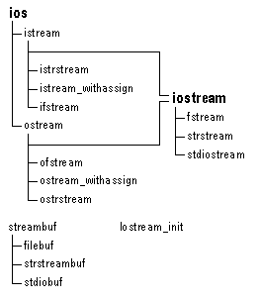
File Handling Classes
Hierarchy Diagram

Slide 72
ios
istream
streambuf
ostream
iostream
ifstream
fstream
ofstream
filebuf
fstreambase

Slide 73
FUNCTIONS OF FILE STREAM CLASSES
filebuf – It sets the buffer to read and write, it contains close() and open() member functions on it.
fstreambase – This is the base class for fstream and, ifstream and ofstream classes. therefore it provides the common function to these classes. It also contains open() and close() functions.
ifstream – Being input class it provides input operations it inherits the functions get( ), getline( ), read( ), and random access functions seekg( ) and tellg( ) functions.
ofstream – Being output class it provides output operations it inherits put( ), write( ) and random access functions seekp( ) and tellp( ) functions.
fstream – It is an i/o class stream, it provides simultaneous input and output operations.

Slide 74
File TYPES
A File can be stored in two ways
Text File
Binary File
Text Files : Stores information in ASCII characters. In text file each line of text is terminated by with special character known as EOF (End of File) In text file some translations takes place when this EOF() character is read or written.
Binary File: it contains the information in the same format as it is held in the memory. In binary file there is no delimiter for a line. Also no translation occur in binary file. As a result binary files are faster and easier for program to read and write.

Slide 75
File modes
The File Mode describes how a file is to be used ; to read from it, write to it, to append and so on
Syntax
Stream_object.open(“filename”,mode);
File Modes
ios::out: It open file in output mode (i.e write mode) and place the file pointer in beginning, if file already exist it will overwrite the file.
ios::in It open file in input mode(read mode) and permit reading from the file.

Slide 76
File modes
ios::app It open the file in write mode, and place file pointer at the end of file i.e to add new contents and retains previous contents. If file does not exist it will create a new file.
ios::ate It open the file in write or read mode, and place file pointer at the end of file i.e input/ output operations can performed anywhere in the file.
ios::trunc It truncates the existing file (empties the file).
ios::nocreate If file does not exist this file mode ensures that no file is created and open() fails.
ios::noreplace If file does not exist, a new file gets created but if the file already exists, the open() fails.
ios::binary Opens a file in binary mode.

Slide 77
Closing a File
A File is closed by disconnecting it with the stream it is associated with. The close( ) function is used to accomplish this task.
Syntax:
Stream_object.close( );
Example :
fout.close();

Slide 78
Steps To Create A File
Declare an object of the desired file stream class
(ifstream, ofstream, or fstream)
2. Open the required file to be processed using constructor or open function.
3. Process the file.
4. Close the file stream using the object of file stream.

Slide 79
eof ( ) Function
This function determines the end-of-file by returning true(non-zero) for end of file otherwise returning false(zero).
Syntax
Stream_object.eof( );
Example :
fout.eof( );

Slide 80
Text File Functions
get() – read a single character from text file and store in a buffer.
e.g file.get(ch);
put() - writing a single character in textfile
e.g. file.put(ch);
getline() - read a line of text from text file store in a buffer.
e.g file.getline(s,80);
We can also use
file>>ch for reading
file<<ch writing in text file
But >> operator does not accept white spaces.

Slide 81
//This program creates a file called “message.dat”
#include <fstream> //Required for file I/O
#include <iostream>
using namespace std;
void main()
{
ofstream myfile ("message.dat“, ios::out | ios::binary);
if (!myfile)
{
//check if the file is opened or not
cout<<"\n Cannot open this file";
return 1;
}
myfile <<"When an apple fell, Newton was disturbed \n";
myfile <<"but, when he found that all apples fell, \n";
myfile <<"it was gravitation that attracts them down,\n";
myfile <<"he was satisfied \n";
myfile.close(); //close the file
getch();
}

Slide 82
Program to create a text file using strings I/O
#include<fstream.h> //header file for file operations
void main()
{
char s[80], ch;
ofstream file(“myfile.txt”,ios::out); //open myfile.txt in default output mode
do
{ cout<<”\n enter line of text”;
gets(s); //standard input
file<<s; // write in a file myfile.txt
cout<<”\n more input y/n”;
cin>>ch;
}while(ch!=’n’);
file.close();
} //end of main

Slide 83
Program to read content of ‘myfile.txt’ and display it on monitor.
#include<fstream.h> //header file for file operations
void main()
{
char ch;
ifstream file(“myfile.txt”,ios::in); //open myfile.txt in default input mode
while(file)
{
file.get(ch) // read a character from text file ‘myfile.txt’
cout<<ch; // write a character in text file ‘myfile.txt ‘
}
file.close();
} //end of main

Slide 84
CBSE QUESTION PATTERN
RELATED
TO
TEXT FILES
2/3 Marks QNO 4 (b)

Slide 85
1. Write a function in C++ to count the number of uppercase alphabets present in a text file “BOOK.txt”
2. Write a function in C++ to count the number of alphabets present in a text file “BOOK.txt”
3. Write a function in C++ to count the number of digits present in a text file “BOOK.txt”
4. Write a function in C++ to count the number of white spaces present in a text file “BOOK.txt”
5. Write a function in C++ to count the number of vowels present in a text file “BOOK.txt”
6. Assume a text file “Test.txt” is already created. Using this file, write a function to create three files “LOWER.TXT” which contains all the lowercase vowels and “UPPER.TXT” which contains all the uppercase vowels and “DIGIT.TXT” which contains all digits.

Slide 86
Binary File Functions
read( )- read a block of binary data or reads a fixed number of bytes from the specified stream and store in a buffer.
Syntax : Stream_object.read((char *)& Object, sizeof(Object));
e.g file.read((char *)&s, sizeof(s));
write( ) – write a block of binary data or writes fixed number of bytes from a specific memory location to the specified stream.
Syntax : Stream_object.write((char *)& Object, sizeof(Object));
e.g file.write((char *)&s, sizeof(s));

Slide 87
Binary File Functions
Note: Both functions take two arguments.
• The first is the address of variable, and the second is the length of that variable in bytes. The address of variable must be type cast to type char*(pointer to character type)
• The data written to a file using write( ) can only be read accurately using read( ).

Slide 88
Program to create a binary file ‘student.dat’ using structure.
#include<fstream.h>
struct student
{
char name[15];
float percent;
};
void main()
{
ofstream fout;
char ch;
fout.open(“student.dat”, ios::out | ios:: binary);
clrscr();
student s;
if(!fout)
{
cout<<“File can’t be opened”;
exit(0);
}

Slide 89
do
{
cout<<”\n enter name of student”;
gets(s.name);
cout<<”\n enter percentage”;
cin>>s.percent;
fout.write((char *)&s,sizeof(s)); // writing a record in a student.dat file
cout<<”\n more record y/n”;
cin>>ch;
}while(ch!=’n’ );
fout.close();
}

Slide 90
Program to read a binary file ‘student.dat’ display records on monitor.
#include<fstream.h>
struct student
{
char name[15];
float percent;
};
void main()
{
ifstream fin;
student s;
fin.open(“student.dat”,ios::in | ios:: binary);
fin.read((char *) &s, sizeof(student)); //read a record from file ‘student.dat’
CONTD....

Slide 91
while(file)
{
cout<<s.name;
cout<<“\n has the percent: ”<<s.percent;
fin.read((char *) &s, sizeof(student));
}
fin.close();
}

Slide 92
CBSE QUESTION PATTERN
RELATED
TO
BINARY FILES
3 MARKS
QNO 4 ( c )

Slide 93
QNO 4 ( C ) Write a function in c++ to search for details (Phoneno and Calls) of those Phones which have more than 800 calls from binary file “phones.dat”. Assuming that this binary file contains records/ objects of class Phone, which is defined below. CBSE 2012
class Phone
{
Char Phoneno[10]; int Calls;
public:
void Get() {gets(Phoneno); cin>>Calls;}
void Billing() { cout<<Phoneno<< “#”<<Calls<<endl;}
int GetCalls() {return Calls;}
};

Slide 94
Ans :
void Search()
{
Phone P;
fstream fin;
fin.open( “Phone.dat”, ios::binary| ios::in);
while(fin.read((char *)&P, sizeof(P)))
{
if(p.GetCalls() >800)
p.Billing();
}
Fin.close(); //ignore
}};

Slide 95
Write a function in C++ to add new objects at the bottom of a binary file “STUDENT.DAT”, assuming the binary file is containing the objects of the following class.
class STUD
{
int Rno;
char Name[20];
public:
void Enter()
{cin>>Rno;gets(Name);}
void Display(){cout<<Rno<<Name<<endl;}
};

Slide 96
Ans.
void searchbook(int bookno)
{ifstream ifile(“BOOK.DAT”,ios::in|ios::binary);
if(!ifile)
{cout<<”could not open BOOK.DAT file”; exit(-1);}
else
{BOOK b; int found=0;
while(ifile.read((char *)&b, sizeof(b)))
{if(b.RBno()==bookno)
{b.Display(); found=1; break;}
}
if(! found)
cout<<”record is not found “;
ifile.close();
}
}

Slide 97
Given a binary file PHONE.DAT, containing records of the following class type
class Phonlist
{
char name[20];
char address[30];
char areacode[5];
char Phoneno[15];
public:
void Register()
void Show();
void CheckCode(char AC[])
{return(strcmp(areacode,AC);
};
Write a function TRANSFER( ) in C++, that would copy all those records which are having areacode as “DEL” from PHONE.DAT to PHONBACK.DAT.

Slide 98
Ans
void TRANSFER()
{
fstream File1,File2;
Phonelist P;
File1.open(“PHONE.DAT”, ios::binary|ios::in);
File2.open(“PHONEBACK.DAT”, ios::binary|ios::OUT)
while(File1.read((char *)&P, sizeof(P)))
{ if( p.CheckCode( “DEL”))
File2.write((char *)&P,sizeof(P)); }
File1.close();
File2.close();
}

Slide 99
File Pointer
The file pointer indicates the position in the file at which the next input/output is to occur.
Moving the file pointer in a file for various operations viz modification, deletion , searching etc. Following functions are used
seekg(): It places the file pointer to the specified position in input mode of file.
e.g file.seekg(p,ios::beg); or
file.seekg(-p,ios::end), or
file.seekg(p,ios::cur)
i.e to move to p byte position from beginning, end or current position.

Slide 100
File Pointer
seekp(): It places the file pointer to the specified position in output mode of file.
e.g file.seekp(p,ios::beg); or file.seekp(-p,ios::end), or file.seekp(p,ios::cur)
i.e to move to p byte position from beginning, end or current position.
tellg(): This function returns the current working position of the file pointer in the input mode.
e.g int p=file.tellg();
tellp(): This function returns the current working position of the file pointer in the output mode.
e.f int p=file.tellp();

Slide 101
CBSE QUESTION PATTERN
RELATED
TO
FILE POINTER
1 MARK
QNO 4 ( a )

Slide 102
4(a) Observe the program segment carefully and answer the question that follows:
class stock
{
int Ino, Qty; Char Item[20];
public:
void Enter() { cin>>Ino; gets(Item); cin>>Qty;}
void issue(int Q) { Qty+=0;}
void Purchase(int Q) {Qty-=Q;}
int GetIno() { return Ino;}
};

Slide 103
void PurchaseItem(int Pino, int PQty)
{ fstream File;
File.open(“stock.dat”, ios::binary|ios::in|ios::out);
Stock s;
int success=0;
while(success= = 0 && File.read((char *)&s,sizeof(s)))
{
If(Pino= = ss.GetIno())
{
s.Purchase(PQty);
_______________________ // statement 1
_______________________ // statement 2
Success++;
}
}

Slide 104
if (success = =1)
cout<< “Purchase Updated”<<endl;
else
cout<< “Wrong Item No”<<endl;
File.close() ;
}

Slide 105
Ans
i) Statement 1 to position the file pointer to the appropriate place so that the data updation is done for the required item.
File.seekp(File.tellg()-sizeof(stock);
OR
File.seekp(-sizeof(stock),ios::cur);
ii) Staement 2 to perform write operation so that the updation is done in the binary file.
File.write((char *)&s, sizeof(s)); OR
File.write((char *)&s, sizeof(stock));

Slide 106
File Open Modes
ios:: app - (append) write all output to the end of file
ios:: ate - data can be written anywhere in the file
ios:: binary - read/write data in binary format
ios:: in - (input) open a file for input
ios::out - (output) open afile for output
ios: trunc -(truncate) discard the files’ contents if
it exists

Slide 107
File Open Modes cont.
ios:nocreate - if the file does NOT exists, the open operation fails
ios:noreplace - if the file exists, the open operation fails

Slide 108
Input and Output
data source:
input device
device driver
input library
our program
data destination:
output library
device driver
output device

Slide 109
The stream model
c
“somewhere”
ostream
(1,234)
123
buffer
An ostream
turns values of various types into character sequences
sends those characters somewhere
E.g., console, file, main memory, another computer

Slide 110
The stream model
c
“somewhere”
istream
(1,234)
123
buffer
An istream
turns character sequences into values of various types
gets those characters from somewhere
E.g., console, file, main memory, another computer

Slide 111
Files
General model
disk
Main memory
I/O system
iostreams
Objects (of various types)
Files
(sequences of bytes)

Slide 112
Files
To read a file
We must know its name
We must open it (for reading)
Then we can read
Then we must close it
That is typically done implicitly
To write a file
We must name it
We must open it (for writing)
Or create a new file of that name
Then we can write it
We must close it
That is typically done implicitly

Slide 113
Opening a file for reading
// …
int main()
{
cout << "Please enter input file name: ";
string iname;
cin >> iname;
ifstream ist {iname}; // ifstream is an“input stream from a file”
// defining an ifstream with a name string
// opens the file of that name for reading
if (!ist) error("can’t open input file ", iname);
// …

Slide 114
Opening a file for writing
// …
cout << "Please enter name of output file: ";
string oname;
cin >> oname;
ofstream ofs {oname}; // ofstream is an “output stream from a file”
// defining an ofstream with a name string
// opens the file with that name for writing
if (!ofs) error("can’t open output file ", oname);
// …
}

Slide 115
I/O error handling
Sources of errors
Human mistakes
Files that fail to meet specifications
Specifications that fail to match reality
Programmer errors
Etc.
iostream reduces all errors to one of four states
good() // the operation succeeded
eof() // we hit the end of input (“end of file”)
fail() // something unexpected happened
bad() // something unexpected and serious happened

Slide 116
Sample integer read “failure”
Ended by “terminator character”
1 2 3 4 5 *
State is fail()
Ended by format error
1 2 3 4 5.6
State is fail()
Ended by “end of file”
1 2 3 4 5 end of file
1 2 3 4 5 Control-Z (Windows)
1 2 3 4 5 Control-D (Unix)
State is eof()
Something really bad
Disk format error
State is bad()

Slide 117
I/O error handling
void fill_vector(istream& ist, vector<int>& v, char terminator)
{ // read integers from ist into v until we reach eof() or terminator
for (int i; ist >> i; ) // read until “some failure”
v.push_back(i); // store in v
if (ist.eof()) return; // fine: we found the end of file
if (ist.bad()) error("ist is bad"); // stream corrupted; let’s get out of here!
if (ist.fail()) { // clean up the mess as best we can and report the problem
ist.clear(); // clear stream state, so that we can look for terminator
char c;
ist >> c; // read a character, hopefully terminator
if (c != terminator) { // unexpected character
ist.unget(); // put that character back
ist.clear(ios_base::failbit); // set the state back to fail()
}
}
}

Slide 118
Throw an exception for bad()
// How to make ist throw if it goes bad:
ist.exceptions(ist.exceptions()|ios_base::badbit);
// can be read as
// “set ist’s exception mask to whatever it was plus badbit”
// or as “throw an exception if the stream goes bad”
Given that, we can simplify our input loops by no longer checking for bad

Slide 119
Reading a single value
// first simple and flawed attempt:
cout << "Please enter an integer in the range 1 to 10 (inclusive):\n";
int n = 0;
while (cin>>n) { // read
if (1<=n && n<=10) break; // check range
cout << "Sorry, "
<< n
<< " is not in the [1:10] range; please try again\n";
}
// use n here
Three kinds of problems are possible
the user types an out-of-range value
getting no value (end of file)
the user types something of the wrong type (here, not an integer)

Slide 120
Reading a single value
What do we want to do in those three cases?
handle the problem in the code doing the read?
throw an exception to let someone else handle the problem (potentially terminating the program)?
ignore the problem?
Reading a single value
Is something we often do many times
We want a solution that’s very simple to use

Slide 121
Handle everything: What a mess!
cout << "Please enter an integer in the range 1 to 10 (inclusive):\n";
int n = 0;
while (cin >> n) {
if (cin) { // we got an integer; now check it:
if (1<=n && n<=10) break;
cout << "Sorry, " << n << " is not in the [1:10] range; please try again\n";
}
else if (cin.fail()) { // we found something that wasn’t an integer
cin.clear(); // we’d like to look at the characters
cout << "Sorry, that was not a number; please try again\n";
for (char ch; cin>>ch && !isdigit(ch); ) // throw away non-digits
/* nothing */ ;
if (!cin) error("no input"); // we didn’t find a digit: give up
cin.unget(); // put the digit back, so that we can read the number
}
else
error("no input"); // eof or bad: give up
}
// if we get here n is in [1:10]

Slide 122
The mess: trying to do everything at once
Problem: We have all mixed together
reading values
prompting the user for input
writing error messages
skipping past “bad” input characters
testing the input against a range
Solution: Split it up into logically separate parts

Slide 123
What do we want?
What logical parts do we what?
int get_int(int low, int high); // read an int in [low..high] from cin
int get_int(); // read an int from cin // so that we can check the range int
void skip_to_int(); // we found some “garbage” character // so skip until we find an int
Separate functions that do the logically separate actions

Slide 124
Skip “garbage”
void skip_to_int()
{
if (cin.fail()) { // we found something that wasn’t an integer
cin.clear(); // we’d like to look at the characters
for(char ch; cin>>ch; ) { // throw away non-digits
if (isdigit(ch) || ch=='-') {
cin.unget(); // put the digit back,
// so that we can read the number
return;
}
}
}
error("no input"); // eof or bad: give up
}

Slide 125
Get (any) integer
int get_int()
{
int n = 0;
while (true) {
if (cin >> n) return n;
cout << "Sorry, that was not a number; please try again\n";
skip_to_int();
}
}

Slide 126
Get integer in range
int get_int(int low, int high)
{
cout << "Please enter an integer in the range "
<< low << " to " << high << " (inclusive):\n";
while (true) {
int n = get_int();
if (low<=n && n<=high) return n;
cout << "Sorry, "
<< n << " is not in the [" << low << ':' << high
<< "] range; please try again\n";
}
}

Slide 127
Use
int n = get_int(1,10);
cout << "n: " << n << endl;
int m = get_int(2,300);
cout << "m: " << m << endl;
Problem:
The “dialog” is built into the read operations

Slide 128
What do we really want?
// parameterize by integer range and “dialog”
int strength = get_int(1, 10,
"enter strength",
"Not in range, try again");
cout << "strength: " << strength << endl;
int altitude = get_int(0, 50000,
"please enter altitude in feet",
"Not in range, please try again");
cout << "altitude: " << altitude << "ft. above sea level\n";
That’s often the really important question
Ask it repeatedly during software development
As you learn more about a problem and its solution, your answers improve

Slide 129
Parameterize
int get_int(int low, int high, const string& greeting, const string& sorry)
{
cout << greeting << ": [" << low << ':' << high << "]\n";
while (true) {
int n = get_int();
if (low<=n && n<=high) return n;
cout << sorry << ": [" << low << ':' << high << "]\n";
}
}
Incomplete parameterization: get_int() still “blabbers”
“utility functions” should not produce their own error messages
Serious library functions do not produce error messages at all
They throw exceptions (possibly containing an error message)

Slide 130
User-defined output: operator<<()
Usually trivial
ostream& operator<<(ostream& os, const Date& d)
{
return os << '(' << d.year()
<< ',' << d.month()
<< ',' << d.day() << ')';
}
We often use several different ways of outputting a value
Tastes for output layout and detail vary

Slide 131
Use
void do_some_printing(Date d1, Date d2)
{
cout << d1; // means operator<<(cout,d1) ;
cout << d1 << d2;
// means (cout << d1) << d2;
// means (operator<<(cout,d1)) << d2;
// means operator<<((operator<<(cout,d1)), d2) ;
}

Slide 132
User-defined input: operator>>()
istream& operator>>(istream& is, Date& dd)
// Read date in format: ( year , month , day )
{
int y, d, m;
char ch1, ch2, ch3, ch4;
is >> ch1 >> y >> ch2 >> m >> ch3 >> d >> ch4;
if (!is) return is; // we didn’t get our values, so just leave
if (ch1!='(' || ch2!=',' || ch3!=',' || ch4!=')') { // oops: format error
is.clear(ios_base::failbit); // something wrong: set state to fail()
return is; // and leave
}
dd = Date{y,Month(m),d}; // update dd
return is; // and leave with is in the good() state
}

Slide 133
Using Input/Output Files
Files in C++ are interpreted as a sequence of bytes stored on some storage media.
The data of a file is stored in either readable form or in binary code called as text file or binary file.
The flow of data from any source to a sink is called as a stream
Computer programs are associated to work with files as it helps in storing data & information permanently.
File - itself a bunch of bytes stored on some storage devices.
In C++ this is achieved through a component header file called fstream.h
The I/O library manages two aspects- as interface and for transfer of data.
The library predefine a set of operations for all file related handling through certain classes.

Slide 134
Using Input/Output Files
A computer file
is stored on a secondary storage device (e.g., disk);
is permanent;
can be used to provide input data to a program or receive output data from a program, or both;
must be opened before it is used.

Slide 135
General File I/O Steps
Declare a file name variable
Associate the file name variable with the disk file name
Open the file
Use the file
Close the file

Slide 136
Using Input/Output Files
Streams act as an interface between files and programs. In C++ . A stream is used to refer to the flow of data from a particular device to the program’s variablesThe device here refers to files, keyboard, console, memory arrays. In C++ these streams are treated as objects to support consistent access interface.
They represent as a sequence of bytes and deals with the flow of data.
Every stream is associated with a class having member functions and operations for a particular kind of data flow.
File -> Program ( Input stream) - reads
Program -> File (Output stream) – write
All designed into fstream.h and hence needs to be included in all file handling programs.
Diagrammatically as shown in next slide

Slide 137
Using Input/Output Files
stream - a sequence of characters
interactive (iostream)
• cin - input stream associated with keyboard.
• cout - output stream associated with display.
file (fstream)
• ifstream - defines new input stream (normally associated with a file).
• ofstream - defines new output stream (normally associated with a file).
Stream of bytes to do input and output to different devices.
Stream is the basic concepts which can be attached to files, strings, console and other devices.
User can also create their own stream to cater specific device or user defined class.

Slide 138
Streams
A stream is a series of bytes, which act either as a source from which data can be extracted or as a destination to which the output can be sent. Streams resemble the producer and consumer model
The producer produces the items to be consumed by the consumer. The producer and the consumers are connected by the C++ operators >> or <<. For instance , the keyboard exhibits the nature of only a producer,printer or monitor screen exhibit the nature of only a consumer. Whereas , a file stored on the disk , can behave as a producer or consumer, depending upon the operation initiated on it.

Slide 139
Predefined console streams
C++ contains several predefined streams that are opened automatically when the execution of a program starts.
cin :standard input (usually keyboard) corresponding to stdio in C
2) cout :standard output (usually screen) corresponding to stdout in C
3) cerr :standard error output (usually screen) corresponding to stderr in C
4) clog : A fully buffered version of cerr (No C equivalent)

Slide 140
Why to use Files
Convenient way to deal large quantities of data.
Store data permanently (until file is deleted).
Avoid typing data into program multiple times.
Share data between programs.
We need to know:
how to "connect" file to program
how to tell the program to read data
how to tell the program to write data
error checking and handling EOF

Slide 141
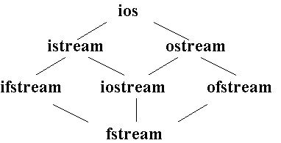
Classes for Stream I/O in C++
When working with files in C++, the following classes can be used:
ofstream – writing to a file
ifstream – reading for a file
fstream – reading / writing
When ever we include <iostream.h>, an ostream object, is automatically defined – this object is cout.
ofstream inherits from the class ostream (standard output class).
ostream overloaded the operator >> for standard output.…thus an ofstream object can use methods and operators defined in ostream.
ios is the base class.
istream and ostream inherit from ios
ifstream inherits from istream (and ios)
ofstream inherits from ostream (and ios)
iostream inherits from istream and ostream (& ios)
fstream inherits from ifstream, iostream, and ofstream

Slide 143
File Modes
Name | Description
ios::in | Open file to read
ios::out | Open file to write
ios::app | All the date you write, is put at the end of the file. It calls ios::out
ios::ate | All the date you write, is put at the end of the file. It does not call ios::out
ios::trunc | Deletes all previous content in the file. (empties the file)
ios::nocreate | If the file does not exist, opening it with the open() function gets impossible.
ios::noreplace | If the file exists, trying to open it with the open() function, returns an error.
ios::binary | Opens the file in binary mode.

Slide 144
File Modes
Opening a file in ios::out mode also opens it in the ios::trunc mode by default. That is, if the file already exists, it is truncated
Both ios::app and ios::ate set the pointers to the end of file, but they differ in terms of the types of operations permitted on a file. The ios::app allows to add data from end of file, whereas ios::ate mode allows to add or modify the existing data anywhere in the file. In both the cases the file is created if it is non existent.
The mode ios::app can be used only with output files
The stream classes ifstream and ofstream open files in read and write modes by default.

Slide 145
File pointers
Each file has two associated pointers known as the file pointers. One of them is called the input pointer or get pointer. The get pointer specifies a location from which the current reading operation is initiated Other is called the output pointer or put pointer. The put pointer specifies a location from where the current writing operation is initiated We can use these pointers to move through the files while reading or writing. The input pointer is used for reading the contents of a given file location and the output pointer is used for writing to a given file location. Functions for manipulation of file pointers seekg() Moves get pointer (input) to a specified location. seekp() Moves put pointer (output) to a specified location. tellg() Gives the current position of the get pointer. tellp() Gives the current position of the put pointer.

Slide 146
File pointers
infile.seekg(10); Moves the file pointer to the byte number 10. The bytes in a file are numbered beginning from zero. Thus, the pointer will be pointing to the 11th byte in the file.
Specifying the offset : The seek functions seekg() and seekp() can also be used with two arguments as follows: seekg(offset, refposition); seekp(offset, refposition); The parameter offset represents the number of bytes the file pointer to be moved from the location specified by the parameter refposition. The refposition takes one of the following these constant defined in the ios class. ios::beg start of the file ios::cur current position of the pointer ios::end end of the file.

Slide 147
File Open Mode
#include <fstream>
int main(void)
{
ofstream outFile("file1.txt", ios::out);
outFile << "That's new!\n";
outFile.close();
Return 0;
}
If you want to set more than one open mode, just use the OR operator- |. This way:
ios::ate | ios::binary

Slide 148
Dealing with Binary files
Functions for binary file handling
get(): read a byte and point to the next byte to read
put(): write a byte and point to the next location for write
read(): block reading
write(): block writing
flush():Save data from the buffer to the output file.

Slide 149
Binary File I/O Examples
//Example 1: Using get() and put()
#include <iostream>
#include <fstream>
void main()
{
fstream File("test_file",ios::out | ios::in | ios::binary);
char ch;
ch='o';
File.put(ch); //put the content of ch to the file
File.seekg(ios::beg); //go to the beginning of the file
File.get(ch); //read one character
cout << ch << endl; //display it
File.close();
}

Slide 150
File I/O Example: Writing
#include <fstream>
using namespace std;
int main(void)
{
ofstream outFile(“fout.txt");
outFile << "Hello World!";
outFile.close();
return 0;
}

Slide 151
File I/O Example: Reading
#include <iostream>
#include <fstream>
int main(void)
{
ifstream openFile(“data.txt"); //open a text file data.txt
char ch;
while(!OpenFile.eof())
{
OpenFile.get(ch);
cout << ch;
}
OpenFile.close();
return 0;
}

Slide 152
File I/O Example: Reading
#include <iostream>
#include <fstream>
#include <string>
int main(void)
{
ifstream openFile(“data.txt"); //open a text file data.txt
string line;
if(openFile.is_open()){ //
while(!openFile.eof()){
getline(openFile,line);//read a line from data.txt and put it in a string
cout << line;
}
else{
cout<<“File does not exist!”<<endl;
exit(1);}
}
openFile.close();
return 0;
}

Slide 153
To access file handling routines:
#include <fstream.h>
2: To declare variables that can be used to access file:
ifstream in_stream;
ofstream out_stream;
3: To connect your program's variable (its internal name) to an external file (i.e., on the Unix file system):
in_stream.open("infile.dat");
out_stream.open("outfile.dat");
4: To see if the file opened successfully:
if (in_stream.fail())
{ cout << "Input file open failed\n";
exit(1); // requires <stdlib.h>}

Slide 154
To get data from a file (one option), must declare a variable to hold the data and then read it using the extraction operator:
int num;
in_stream >> num;
[Compare: cin >> num;]
6: To put data into a file, use insertion operator:
out_stream << num;
[Compare: cout << num;]
NOTE: Streams are sequential – data is read and written in order – generally can't back up.
7: When done with the file:
in_stream.close();
out_stream.close();

Slide 155
Reading /Writing from/to Binary Files
To write n bytes:
write (const unsigned char* buffer, int n);
To read n bytes (to a pre-allocated buffer):
read (unsighed char* buffer, int num)
#include <fstream.h> main() { int array[] = {10,23,3,7,9,11,253}; ofstream OutBinaryFile("my_b_file.txt“, ios::out | ios::binary); OutBinaryFile.write((char*) array, sizeof(array));
OutBinaryFile.close(); }

Slide 156
C++ has some low-level facilities for character I/O.
char next1, next2, next3;
cin.get(next1);
Gets the next character from the keyboard. Does not skip over blanks or newline (\n). Can check for newline (next == '\n')
Example:
cin.get(next1);
cin.get(next2);
cin.get(next3);
Predefined character functions must #include <ctype.h> and can be used to
convert between upper and lower case
test whether in upper or lower case
test whether alphabetic character or digit
test for space

Slide 157
Reading /Writing from/to Textual Files
#include <fstream.h> main() { // Writing to file ofstream OutFile("my_file.txt"); OutFile<<"Hello "<<5<<endl; OutFile.close(); int number; char dummy[15];
// Reading from file ifstream InFile("my_file.txt"); InFile>>dummy>>number;
InFile.seekg(0); InFile.getline(dummy,sizeof(dummy)); InFile.close(); }
To write:
put() – writing single character
<< operator – writing an object
To read:
get() – reading a single character of a buffer
getline() – reading a single line
>> operator – reading a object

Slide 158
Binary file operations
In connection with a binary file, the file mode must contain the ios::binary mode along with other mode(s)
To read & write a or on to a binary file,
as the case may be blocks of data are accessed through
the use of C++ read() and write() respectively.

Slide 159
Handling binary data
#include <fstream.h>
using namespace std;
int main()
{
ifstream in(“binfile.dat”);
ofstream out(“out.dat”);
if(!in || !out) { // return}
unsigned int buf[1024];
while(!in)
{
in.read(buf, sizeof(unsigned int)*1024);
out.write(buf, sizeof(unsigned int)*1024);
}

